Slide 1


Data visualisation and storytelling
Interactive visualisation
Neil Scheidwasser
August 2024

Slide 2
Why do we visualise data?
Exploration: to reveal, discover patterns in a dataset
Explanation: to communicate information concisely to the public, to a journal…
Main types of research outputs
External
Internal
Papers
Slides
Reports
Websites
Code
(Notebooks)
Interactive!

Slide 3
Why interactive?
For the data scientists:
Present lots of data
Present lots of dimensions at once
For the (re)viewers/public:
Easy to explore
Accessible
Engaging
Good for storytelling
https://www.dr.dk/nyheder/webfeature/election-2019

Slide 4

In practice

Slide 5
The golden standard package install.packages(“plotly”)
Two main ways to make plots:
Easy level: ggplotly = ggplot2 + plotly
Medium level: plot_ly for more exotic plots

Slide 6
Easy level: ggplotly
library(tidyverse)
library(plotly)
# Read the CSV file
us_temps <- read_csv("../data/noaa_us_t2_table.csv", skip = 5) %>%
select(1:13) %>% # Select month columns
filter(Year < 2020) %>% # Remove 2020
rowwise() %>% # Find average across all months
mutate(
# Average + Fahrenheit to Celsius
Avg = (mean(c_across(2:13), na.rm = TRUE) - 32) * (5 / 9),
) %>%
select(Year, Avg) # Select Year and Average columns
# ggplot with line plot
fig <- ggplot(data = us_temps, aes(x = Year, y = Avg)) +
geom_line(size = 1) +
# y label
labs(y = "Average US Temperature (°C)") +
theme_classic() +
theme(
axis.text.x = element_text(size = 11L), # font size
axis.text.y = element_text(size = 11L)
)
# Plotly comes in here with custom height and width
plotly_fig <- ggplotly(fig, height = 500, width = 500) plotly_fig
If you know/use ggplot2, you only need to know one function!
ggplotly

Slide 7
Plotly fundamentals: layout fig %>% layout(…)
Argument | Description | Type | Example
annotations | Add annotations to the plot | List[List] | list(list(x = 3, y = 20, text = "Annotation"))
autosize | If True, automatically adjust size to fit the container where it’s displayed | Boolean
font | Configure font | List | list(family = “Arial”, size = 14)
legend | Configure legend | List | list(x = 0.7, y = 0.9, …)
margin | Margins around plot Left/right/top/bottom + padding |  | list(l = 50, r = 50, b = 100, t = 100, pad = 4)
title | Plot title | Character | “Plot Title Goes Here”
xaxis, yaxis | Configure the x/y axes | List | list(title = “x axis”, showgrid = TR)

Slide 8
Plotly fundamentals: style fig %>% style(…)
Argument | Description | Type | Example
color, size, opacity | Marker size/color/opacity
line | Style a line plot | List[List] | list(color = 'gold')
hoverinfo | Change content when hovering on a point | Character | “x+y+text”, “y”, “x+y”…
hoverlabel | Change appearing when hovering on a point | List | list(bgcolor = “white”)
symbol | Marker symbol | List | “circle”, “square”, “diamond”
textfont | Font for text labels associated with the trace | List | list(family = “Arial”, size = 14)

Slide 9
Example
# Create a ggplot object
gg <- ggplot(mtcars, aes(x = wt, y = mpg)) +
geom_point() +
labs(title = "GGPlot Example", x = "Weight", y = "MPG") +
theme_classic()
# Convert the ggplot object to a Plotly plot
plot <- ggplotly(gg, width = 500, height = 500)
# Modify the layout and the style
plot <- plot %>%
layout(
xaxis = list(title = "<b>Weight (lbs)</b>", showgrid = T),
yaxis = list(title = "<b>Miles per Gallon</b>"),
legend = list(x = 0.7, y = 0.9),
annotations = list(list(x = 3, y = 20, text = "Annotation")),
font = list(family = "Arial", size = 14),
paper_bgcolor = "white"
) %>%
style(
hoverinfo = "text",
hoverlabel = list(bgcolor = "white")
)
# Display the modified plot
plot

Slide 10
Medium level: Heatmaps plot_ly
Argument | Description
x, y | x/y labels (if not z) otherwise values
z, data | Values (z for heatmaps)
type | Plot type | “heatmap”, “scatter”, “bar”, “sankey”
mode | Plotting mode for scatter plots | “markers”, “line”
colors | List of colors
plot_ly(
y = rownames(heatmap_matrix_ordered),
x = colnames(heatmap_matrix_ordered),
z = heatmap_matrix_ordered,
type = "heatmap",
colors = colorRampPalette(c("#c13639", "white", "#2f79b5"))(100)
)

Slide 11
Medium level: Heatmaps heatmaply
Plotly heatmaps made easy + clustering
Argument | Description | Type
x | Matrix to plot | matrix
colors | List of colors | character
show_dendrogram | If True, show the clustering dendrogram | Logical
key.title | Title of the colorbar | Character
library(heatmaply)
heatmaply(
heatmap_matrix_ordered,
colors = colorRampPalette(c("#c13639", "white", "#2f79b5")),
show_dendrogram = F
)

Slide 12
Medium level: Networks
There are plenty of ways with various libraries
If we use igraph, we need two things:
A list of nodes
A list of edges
A layout
Step 1: prepare the data
library(igraph)
library(igraphdata)
data("UKfaculty", package="igraphdata")
# Upgrade the graph
G <- upgrade_graph(UKfaculty)
# Edges and nodes
edges <- as.data.frame(get.edgelist(G))
nodes <- V(G)
# Layout
nice_layout <- layout_nicely(G)
# X and Y positions
Xn <- nice_layout[, 1]
Yn <- nice_layout[, 2]
library(igraph)
library(igraphdata)
data("UKfaculty", package="igraphdata")
# Upgrade the graph
G <- upgrade_graph(UKfaculty)
# Edges and nodes
edges <- as.data.frame(get.edgelist(G))
nodes <- V(G)
# Layout
nice_layout <- layout_nicely(G)
# X and Y positions
Xn <- nice_layout[, 1]
Yn <- nice_layout[, 2]

Slide 13
Medium level: Networks
There are plenty of ways with various libraries
If we use igraph, we need two things:
A list of nodes
A list of edges
A layout
Step 2: plot the nodes
library(randomNames)
# Begin plot
network <- plot_ly(
type = "scatter",
mode = "markers"
)
# Add trace for nodes
network <- network %>% add_trace(
x = Xn, y = Yn,
# Size of the points depends on the degree
marker = list(size = degree(G)),
# Text = random names
text = randomNames(length(nodes)),
hoverinfo = "text",
name = "Faculty members"
)

Slide 14
Medium level: Networks
There are plenty of ways with various libraries
If we use igraph, we need two things:
A list of nodes
A list of edges
A layout
Step 3: plot the edges
# Axis with no grid, no title, no ticks, no lines
axis <- list(
title = "",
showgrid = FALSE,
showticklabels = FALSE,
zeroline = FALSE
)
fig <- layout(
network,
# cf. "tips and tricks"
shapes = get_edge_shapes(edges, Xn, Yn),
xaxis = axis,
yaxis = axis
)
fig

Slide 15

Medium level: Maps
install.packages(“tmap”)
We already saw it yesterday!

Slide 16
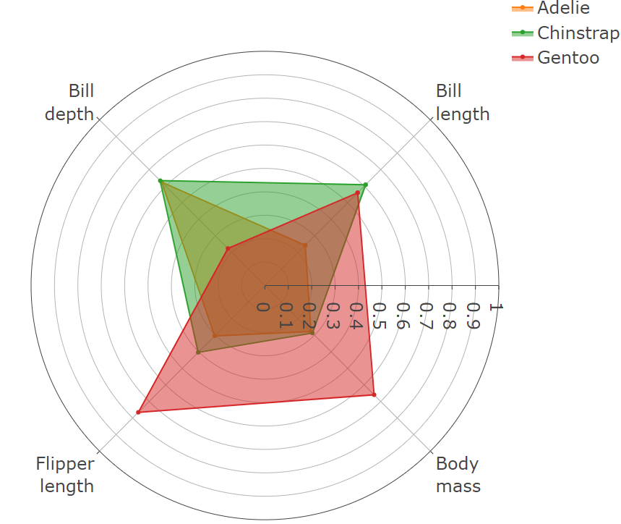
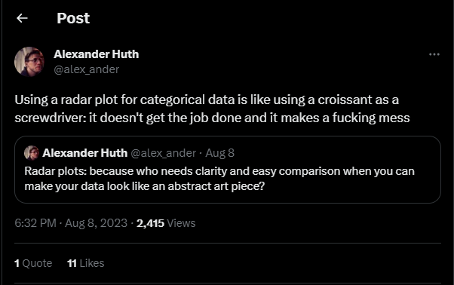
More exotic plots: radar charts
To directly compare groups based on several variables

Slide 17
More exotic plots: Radar charts
library(palmerpenguins)
library(plotly)
# mean_values <- mean + min-max-normalisation of penguins
# Start figure
fig <- plot_ly(
type = "scatterpolar", # tell plotly we are doing a radar chart
mode = "lines+markers", # plot points and lines
fill = "toself“ # to fill the inside of the plot with colour
)
all_species <- mean_values$species
for (i in 1:length(all_species)) {
species_values <- as.character(
mean_values %>%
filter(species == all_species[[i]]) %>% column_to_rownames("species")
)
# Add a radar plot trace fig <- fig %>% add_trace(
r = c(species_values, species_values[[1]]),
theta = c(attributes, attributes[1]),
name = all_species[[i]]
)
}
fig %>%
layout(
polar = list(
radialaxis = list(range = c(0, 1)),
angularaxis = list(rotation = 45)
),
font = list(size = 16))
Argument | Description
r | Tick values
theta | Tick names/angles
name | Name of subplot/plot
angularaxis | In layout: angular parameters (e.g, to rotate the plot)
radialaxis | In layout: radial parameters (e.g, to rotate the plot)
attributes <- c("bill_length_mm", "bill_depth_mm", "flipper_length_mm", "body_mass_g")
# Min-max normalisation
normalized_penguins <- penguins %>%
mutate(across(
attributes,
~ (. - min(., na.rm = TRUE)) / (max(., na.rm = TRUE) - min(., na.rm = TRUE))
))
# Mean by species
mean_values <- normalized_penguins %>%
group_by(species) %>%
summarise(across(c(attributes), mean, na.rm = TRUE))

Slide 18
More exotic plots: Sankey plots
To depict flows from a set of values to another

Slide 19
More exotic plots: Sankey plots
fig <- plot_ly(
type = "sankey",
orientation = "h",
node = list(
label = c("Alice's expense (in $)", "Bob's expense (in $)", "How much Alice ate", "How much Bob ate", "Cheese platter", "Wine"),
pad = 15,
thickness = 20,
line = list(
color = "black",
width = 0.5
)
),
link = list(
source = c(0, 1, 0, 2, 3, 3),
target = c(2, 3, 3, 4, 4, 5),
value = c(8, 4, 2, 8, 4, 2)
)
)
Argument | Description | Example
orientation | Vertical or horizontal flow
node | List of nodes | list( label = c(“A”, “B”, C”), thickness = 20, pad = 15 )
link | List of links between nodes | list( source = source_nodes, target = target_nodes, value = link_values )

Slide 20
Hard-but-not-too-difficult-hopefully level: web apps! install.packages(“shiny”)
Maybe a bit less approachable than ggplot2 and plotly, but excellent for interactive storytelling
https://shiny.posit.co/r/gallery/life-sciences/covid19-tracker/

Slide 21
Hard-but-not-too-difficult-hopefully level: web apps! install.packages(“shiny”)
Shiny scripts (or apps) require three components:
Frontend: a user interface object ui
Backend: A server function server <- function(input, output)
input: the input required from the user
output: the output plot
A linker to create the app: shinyApp(ui = ui, server = server)

Slide 22






Frontend and backend
Frontend = presentation layer
Common focuses:
User Interface (UI)
Accessibility
Web performance
Web design
Backend = data access layer
Common focuses:
Algorithms, core logic of the application
Data management, engineering, analysis
Security

Slide 23


Slide 24
Example: A histogram with varying number of bins
User interface:
Server:
# Define UI for app that draws a histogram
ui <- fluidPage( # App title
titlePanel("Hello Shiny!"),
# Sidebar layout with input and output definitions
sidebarLayout( # Sidebar panel for inputs ----
sidebarPanel( # Input: Slider for the number of bins
sliderInput(
inputId = "bins",
label = "Number of bins:",
min = 1, max = 50, value = 30
)
),
# Main panel for displaying outputs
mainPanel( # Output: Histogram
plotOutput(outputId = "distPlot")
)
)
)
# Define server logic required to draw a histogram ----
server <- function(input, output) {
# Histogram of the penguins’ body masses
# with requested number of bins
# 1. Process data
penguins <- na.omit(penguins)
# 2. Wrap the plot in renderPlot to
# - It is "reactive" and therefore should be automatically
# re-executed when inputs (input$bins) change
# - Its output type is a plot
output$distPlot <- renderPlot({
ggplot(penguins, aes(x = body_mass_g)) +
geom_histogram(bins = input$bins) +
labs(
x = "Body mass(g)",
main = "Body mass of Palmer Penguins"
)
})
}
output =
the histogram
input =
number of bins

Slide 25
What to put in the server (backend)?
That’s the “easy” part ☺ You should put:
Everything related to data analysis
The data visualisation (using ggplot2, plotly…)

Slide 26
What to put in the UI (frontend)?
The basic/easiest skeleton:
Use the fluidPage function
2 main arguments:
sidebarLayout = 3 main arguments:
ui <- fluidPage(
titlePanel("title panel"),
sidebarLayout(
position = "right",
sidebarPanel("sidebar panel"),
mainPanel("main panel")
)
)
Argument | Description
titlePanel | The title of the app
sidebarLayout | Layout with one sidebar panel and a main panel
Argument | Description
position | Where to put the sidebar panel
sidebarPanel | The content of the sidebar panel
mainPanel | The content of the main panel

Slide 27
What to put in the UI (frontend)?
Skeleton with input/output:
Add a widget to control the input in the sidebar panel:
At least 2 arguments for each widget:
ui <- fluidPage(
titlePanel("Hello Shiny!"),
sidebarLayout(
sidebarPanel(
# Slider input
sliderInput(
inputId = "bins",
label = "Number of bins:",
min = 1, max = 50, value = 30
)
),
mainPanel(“main panel")
)
)
Argument | Description
numericInput | Field to enter numbers
selectInput | A box with choices to select from
sliderInput | A slider bar
Argument | Description
inputId | The name of the input
label | The title of the widget

Slide 28
What to put in the UI (frontend)?
Skeleton with input/output:
Display a reactive output:
One main argument for plotOutput:
ui <- fluidPage(
titlePanel("Hello Shiny!"),
sidebarLayout(
sidebarPanel(
# Slider input
sliderInput(
inputId = "bins",
label = "Number of bins:",
min = 1, max = 50, value = 30
)
),
mainPanel(
# Plot output
plotOutput(outputId = "distPlot")
)
)
)
Argument | Description
dateTableOutput, tableOutput | Creates a table
plotOutput | Creates a plot
Argument | Description
outputId | The name of the output plot

Slide 29
Reactivity
# Our plot changes with input$species -> reactive
s <- reactive({
input$species
})
# s is now reactive
# -> write s()
s_body_mass <- reactive({
penguins %>%
filter(species == s()) %>%
select(body_mass_g)
})
# s_body_mass is now reactive
# -> write s_body_mass()
output$distPlot <- renderPlot({
ggplot(s_body_mass(), aes(x = body_mass_g)) +
geom_histogram() +
labs(
x = "Body mass(g)",
main = "Body mass of Palmer Penguins"
)
})
Sometimes your data analysis or plot is dependent on the input
Ex:
Input = penguin species
Output = distribution of their body mass
Then you need your data to be reactive
To get the value of a reactive variable, you call it like a function()

Slide 30
Bonus: animations install.packages(“gganimate”)
Key point here is “transition_time” to set how the points will change from one frame to another
library(gganimate)
library(gapminder)
rstat <- ggplot(
gapminder,
aes(x = gdpPercap, y = lifeExp,
size = pop, colour = country
)
) +
geom_point(show.legend = FALSE, alpha = 0.7) +
scale_color_viridis_d() +
scale_size(range = c(2, 12)) +
scale_x_log10() +
labs(x = "GDP per capita", y = "Life expectancy")
ranim <- rstat +
transition_time(year) +
labs(title = "Year: {frame_time}")
animate(ranim)

